Slide 1
Software Engineering and Architecture
HotStone GUI using MiniDraw
Finally, we may play a game!

Slide 2
The Framework Iteration
Learning Objectives:
  Frameworks:
    Use MiniDraw HotSpots to build a GUI for HotStone
      Tailoring Tools (interaction), Model (domain coupling), and View (Gfx)
    See MiniDraw as example of a framework
    See a lot of patterns in action
  “TDD” as process with visual (non-automated) testing
    TDD is a process:
      Keep focus, take small steps, follow the rhythm
    … and we will develop our GUI in that manner
    … but have to rely on visual/manual testing
      Unfortunately, no automated testing

Slide 3
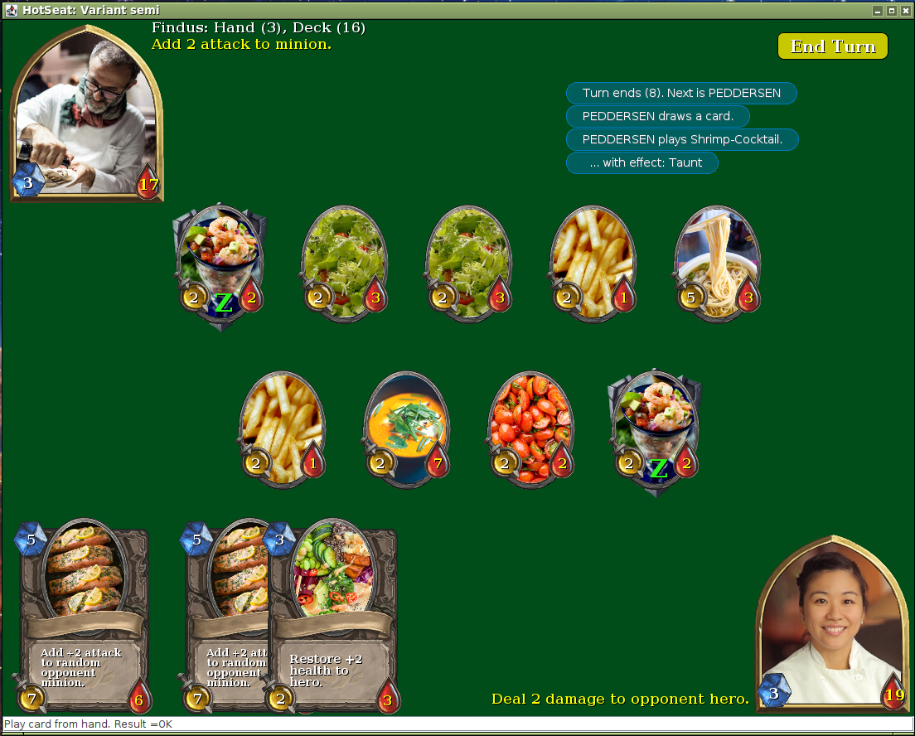
What will the Product be?
A ‘hotseat’
UI for two
players on
a single
computer
Swap seat
in front
of the UI
Demo!

Slide 4
Analysis
GUI elements are obvious, but… never-the-less:
Favor object composition
  Core = Domain = HotStone
    Card, Hero, Player, Game
  Edge = GUI = MiniDraw Gfx
    Figure, Tool, Drawing, View
Graphical elements
representing Game elements
  Card CardFigure
  Hero HeroFigure
  Etc.

Slide 5
Analysis
Thus crafting/growing a GUI …
  (using MiniDraw or LibGdx or Unity or UnrealEngine or …)
… entails …
  Drawing graphical elements representing domain elements
  Translating user actions on these Gfx elements into domain mutator calls
    Drag CardFigure from hand up on the field playCard(…)
    Etc
  Translating domain state changes into Gfx updates
    onHeroUpdate() HeroFigure gfx update with new health

Slide 6
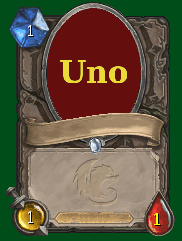
Analysis
In our Iteration 8 mandatory this entails…
  Drawing Gfx
    MiniDraw Figure HotSpot. Provided by me!
  Translating user actions to mutator calls
    MiniDraw Tool HotSpot. Initial work provided, fill in!
      FRS §37.7.4
  Translating game state changes into Gfx updates
    Observer on Game. Solved in Iteration 7
    MiniDraw Drawing HotSpot. Initial work provided, fill in!
      FRS §37.7.3

Slide 7
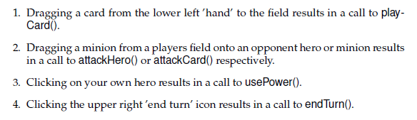
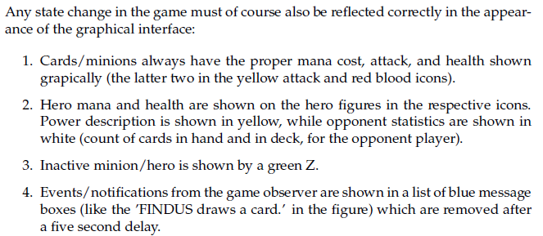
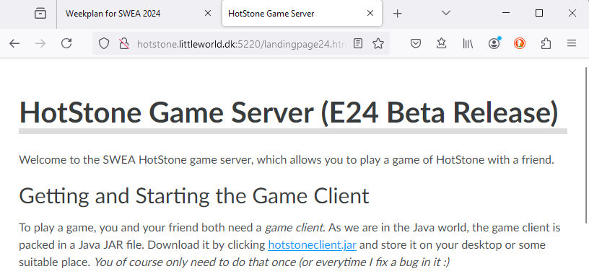
§37.7.1 User Stories
Read FRS §37.7.1 or play the game for requirements…

Slide 8
Software Architecture Views
A short detour

Slide 9
Views in Architecture
In the software architecture field it is acknowledged that any architecture can be viewed from at least three perspectives:
  The runtime perspective / functional view
    What objects are present at runtime – how do they interact – what is the protocol?
      Sequence diagrams and dynamics
  The compile-time perspective / module view
    What packages, interfaces, classes are there?
      Class and package diagrams
  The allocation/deployment view
    What machines are there? What programs are running on them
Of course, highly related to each other…

Slide 10
The Runtime View
Coupling Domain and GUI together

Slide 11
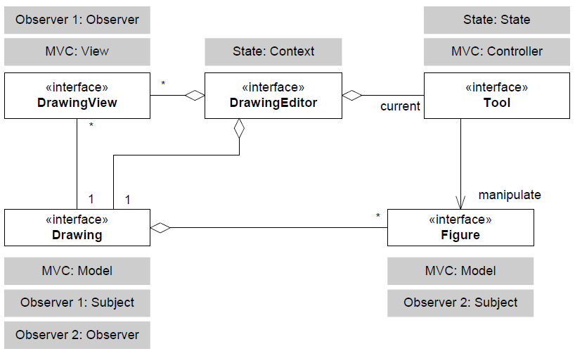

GUI ⬄ Domain
What does this entail?
Information flow analysis
  Translating movement of Figures into game mutations
  Translating game state changes into 2D Gfx updates
Alas a rough Test List with two headlines
  1. From GUI to Domain
  2. From Domain to GUI

Slide 12
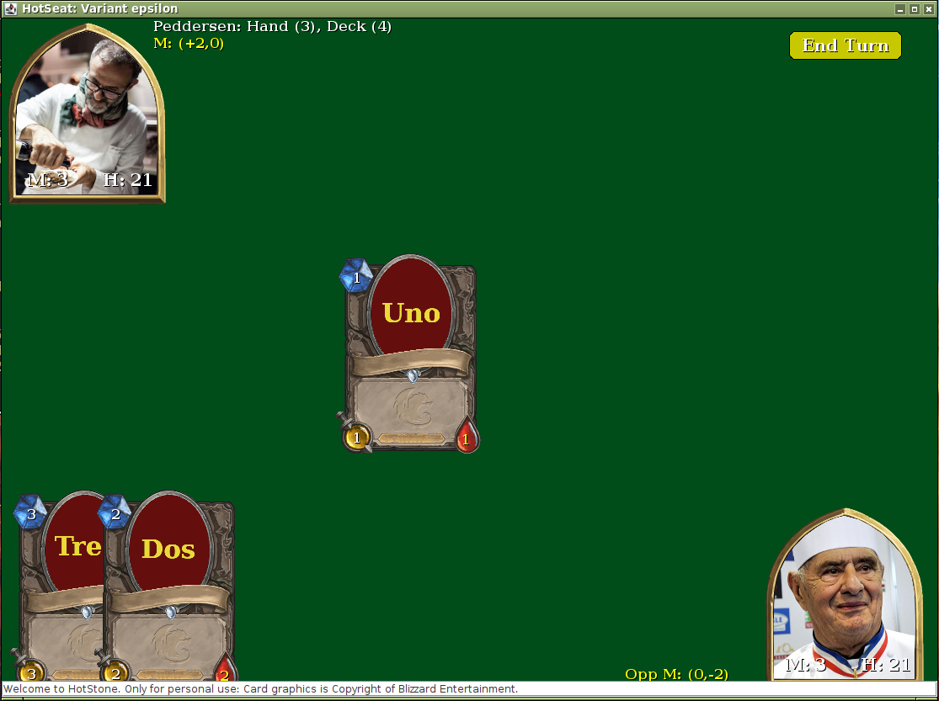
By Example (1)
As example:
  I drag ‘Uno’ from
  hand to field using the
  mouse
  Translates to
    game.playCard(…);
From GUI to Domain

Slide 13
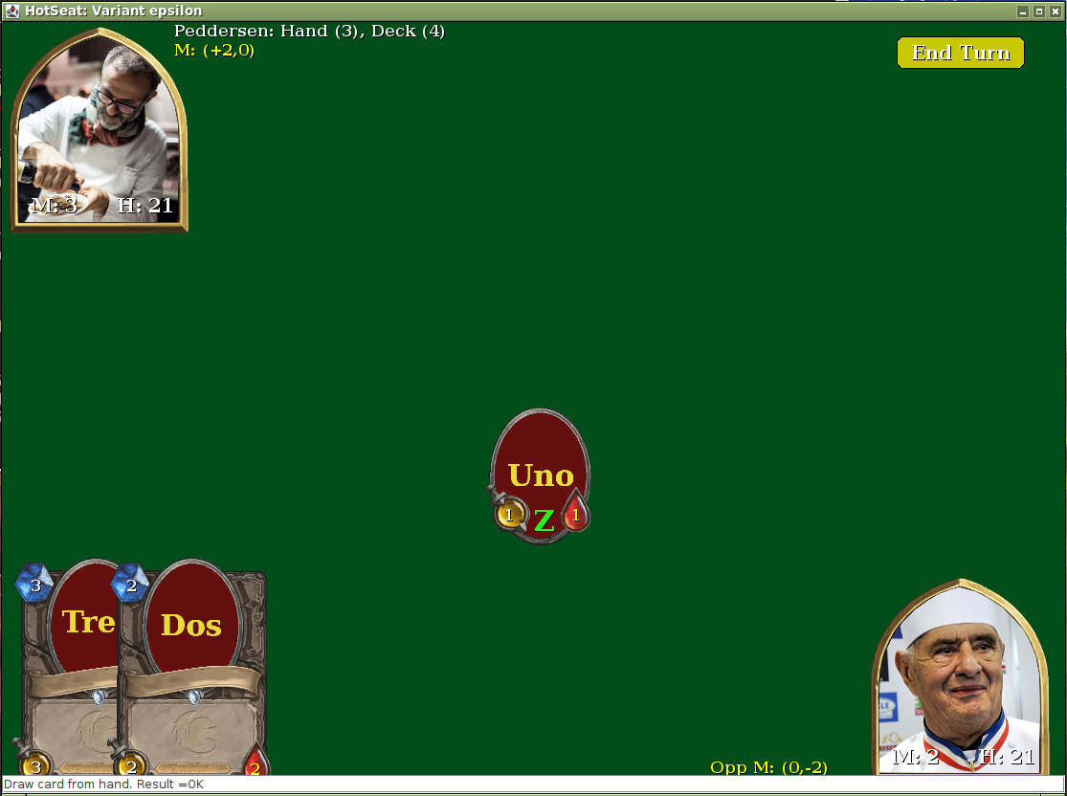
By Example (2)
… Which …
  … makes Game fire a
  onPlayCard() event
  … caught by MiniDraw
  which deletes
  CardFigure and
  adds a MinionFigure
From Domain to GUI

Slide 14
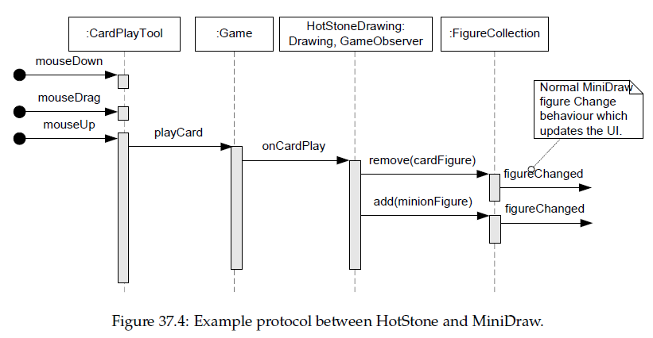
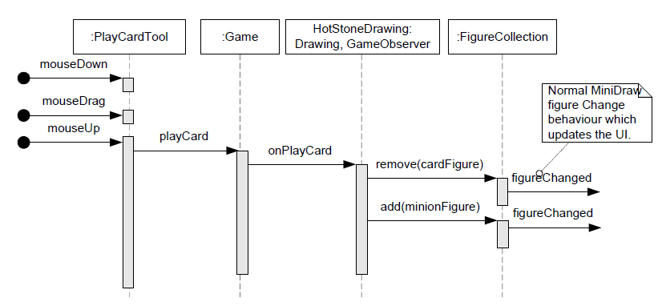
Or as UML

Slide 15
Patterns Involved
MVC:Controller (Tool)
MVC:Model
MVC:View
Facade
Observer
Internal MiniDraw redrawing
GUI ⇒ Domain ⇒ GUI

Slide 16


Divide and Conquer
Exercise is split into two – one for each direction…
Exercise: Why do it in this order?
Notes:
Because we have more pieces already in the first part: the domain is there, the observer is there, only missing is GUI code

Slide 17
Domain to GUI
First Task

Slide 18
Domain to GUI
Translating game state changes into Gfx updates
    Observer on Game. Solved in Iteration 7
    MiniDraw Drawing HotSpot. Initial work provided, fill in!
      FRS §37.7.3
What do we have?
  The GameObserver – emitting state change events
    Ex.: a card is drawn to hand
What should then happen?
  Card appearing
    I.e. ‘f = new CardFigure(…); add(f);’
    in the Drawing role of MiniDraw

Slide 19
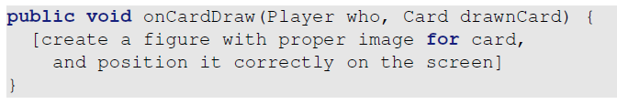
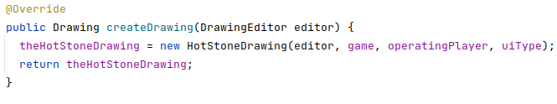


Domain to GUI
Solution:
  Make a special purpose Drawing that receives events from the Game – Serving the Drawing role and the GameObserver role
  And A) couple that to the game and B) inject into MiniDraw

Slide 20
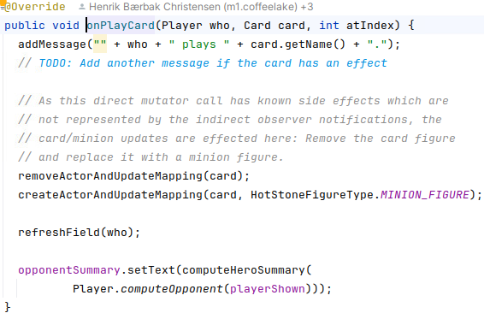
Domain to GUI
Thus, reacting upon onCardDraw() is then just executing the corresponding graphical manipulations
  onCardDraw() is part of the exercise, but another examples is:
  onCardPlay() is implemented in provided code
    Remove CardFigure
    Add MinionFigure
    Layout battle field

Slide 21
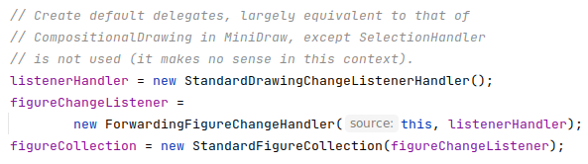
Compositional Drawing
Implementing Drawing may be tedios though
Why – because all methods must be implemented anew
  The collection of figures, the FigureEvent system, the …
Favor object composition
  Reuse smaller, highly specialized, objects
  Thus it is done in 3 lines of code + delegation methods

Slide 22
GUI to Domain
Second Task

Slide 23
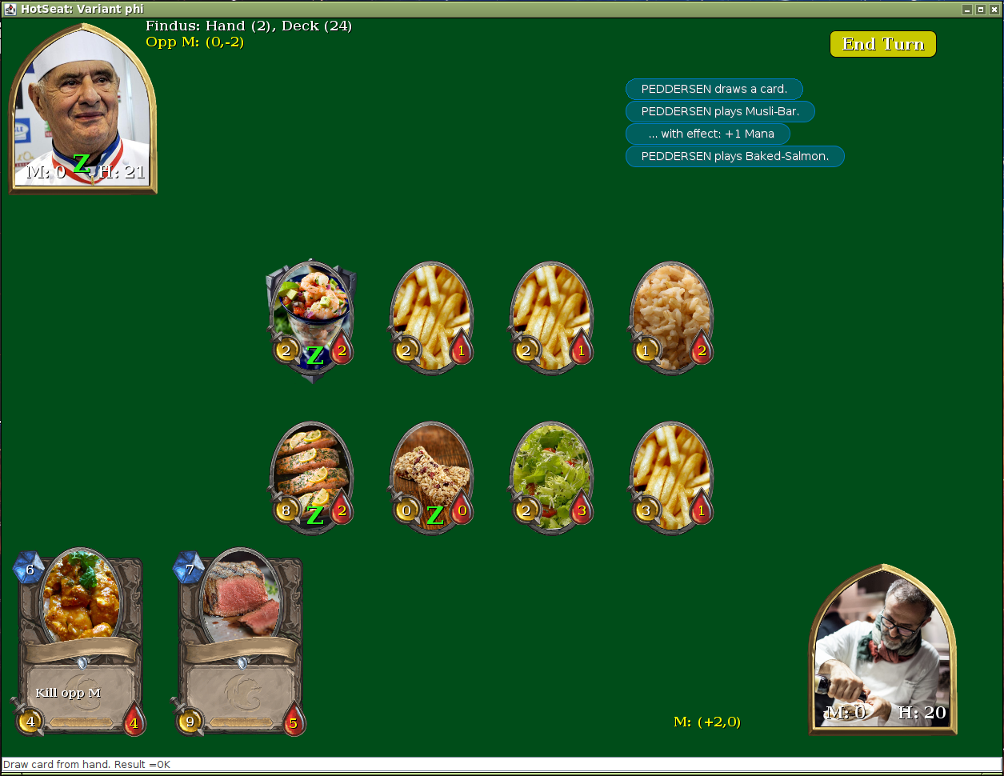
GUI to Domain
The four actions
Exercise
  Given a user clicks somewhere, what determines which of the above four actions is the wanted action?

Slide 24
GUI to Domain
Analysis
  Whatever the ‘mouse down’ event ‘hits’ on the GUI determines what the user wants
    The (x,y) is on top of a figure
      A card
      A minion
      A hero
      A button
4
2
3
1

Slide 25
Selecting What To Do
Thus
  On mouseDown() we determine which action is relevant
  All further mouse events must be processed accordingly
    mouseUp() does different things
Change behavior according to which state system is in
  Ring a bell?
Exercise: What Design Pattern is Involved?

Slide 26
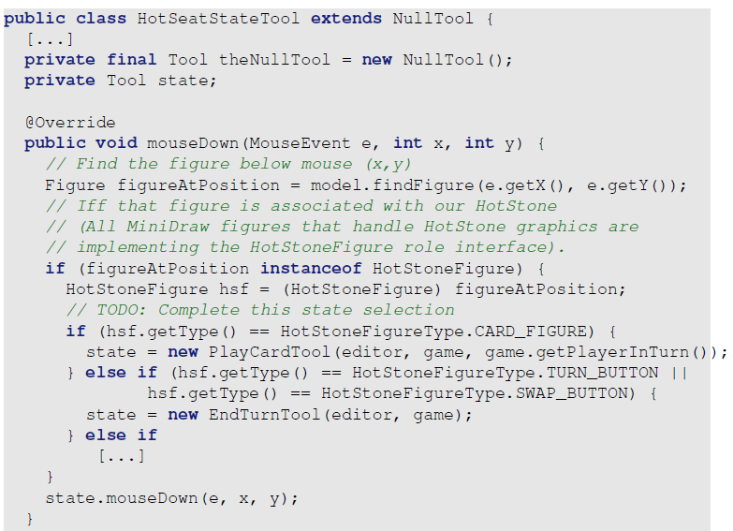
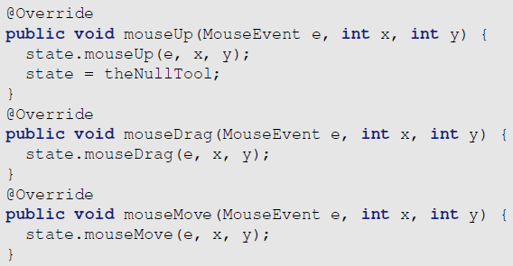
A HotSeatStateTool
Favor Composition, avoid The Blob
  A state tool that delegates to sub tools

Slide 27
Development Process
How to implement this in
a small steps way?

Slide 28
The Issue
If we…
  Implement GUI to Domain code first – there is no visual feedback
    As there are no ‘Domain to GUI’ code in place to update Gfx ☹
  Implement the Domain to GUI code first – then nothing happens
    As there is no way to force any state changes ☹
      (no game mutator calls)
Solution: Need something to break the dependency
FakeObject: Replacement object that is a lightweight implementation of near-realistic behavior

Slide 29
Domain To GUI
We start in this end…
… and must fake the state
changes on game
  Some other means of calling
    game.playCard(…)
    game.attackHero(…)
  … than using the UI itself
We do it using a ‘FakeObject’ tool, constructed just for this particular development task (ala a Junit test case)

Slide 30

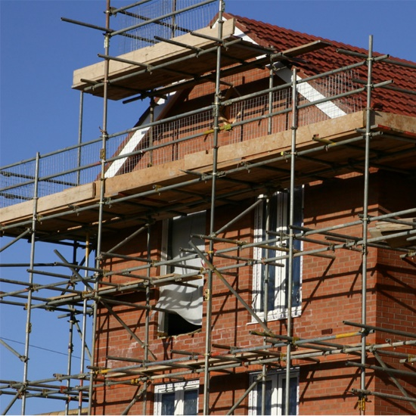
Scaffolding
Scaffolding:
Scaffolding code:
  Code to help us build the production
  code, not part of the production
  itself
    A manual ‘JUnit’ pendant…

Slide 31
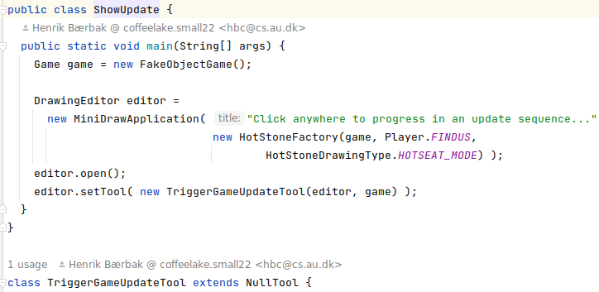
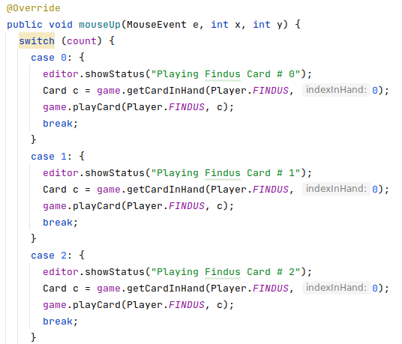

Scaffolding Tool

Slide 32
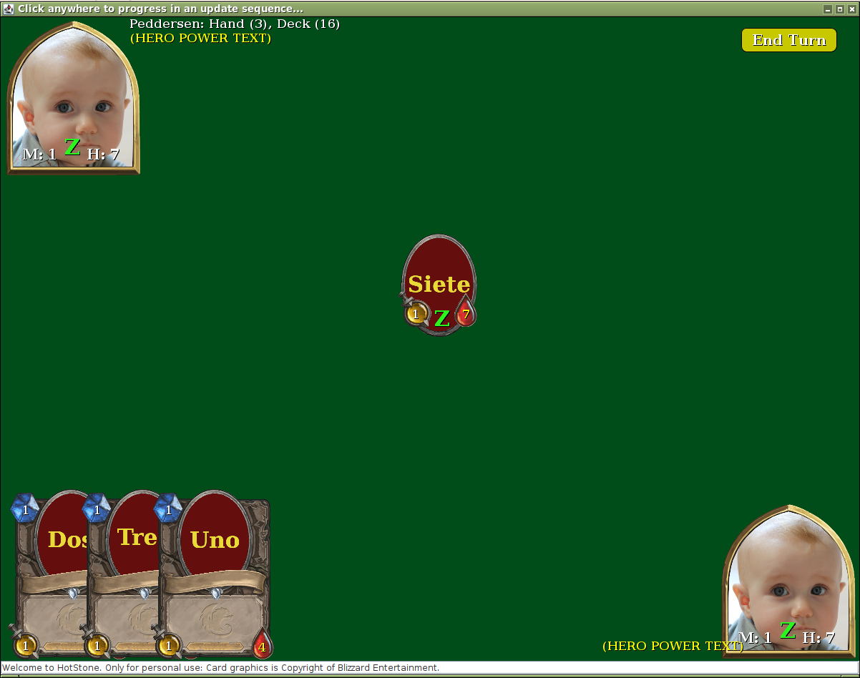
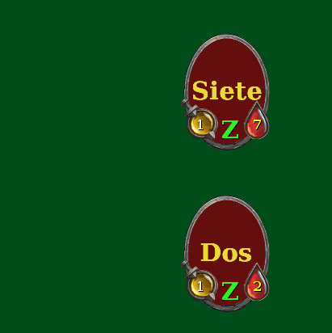

Demo
Click First time
  = first test case

Slide 33
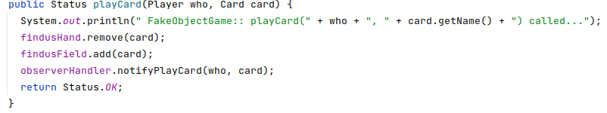
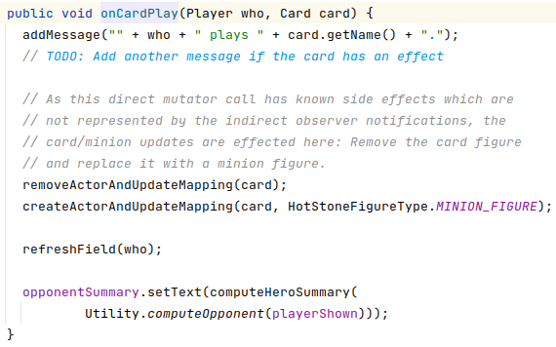

Why Does This Work?
I am sure it was called

Slide 34
Demo
Click Second time
  = second test case
… and see the right thing happen visually
And so on…

Slide 35
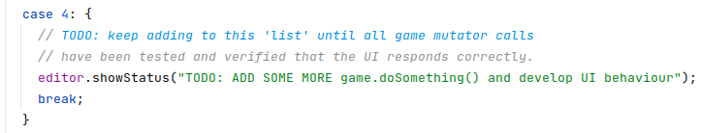

The Point
ShowUpdate program is a visual test program
  To Test Drive the full HotStoneDrawing implementation
  To add test cases, put tests into the TriggerGameUpdate tool
  Add case 5, 6, … until all mutators in game can be called and the Gfx is updated correctly!

Slide 36
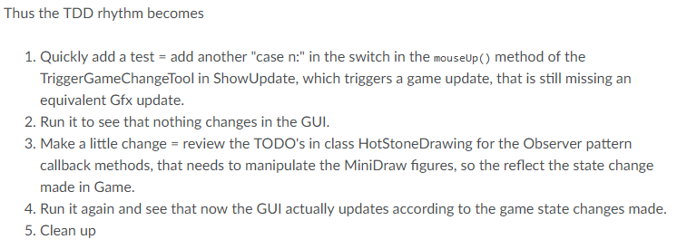
Alas the Rhythm

Slide 37
Test Double or Not?
You can do this using Test Doubles
  A FakeObjectGame that mimic a real game but with stubbed/canned behavior
  Experience: It becomes almost like developing AlphaStone all over again…
    Laborious and even ripe for coding errors in the FakeObject ☹
You can do this using a simple HotStone variant
  Like e.g. AlphaStone
  Argument: At this point our AlphaStone should be pretty ‘… code that works’ without defects and thus may serve as basis for incrementally developing our GUI

Slide 38
But (1)…
There are some trap if you change to, say, AlphaStone
First:
  AlphaStone Hero has tree mana
  And cards (Tres, Dos, Uno)
Thus – is this ‘test sequence’
valid?
  Answer: No
    Argue why?
Morale: Change the sequence!
Notes:
Because fielding tres + dos + uno will cost 6 mana and of course your AlphaStone will object to that!

Slide 39
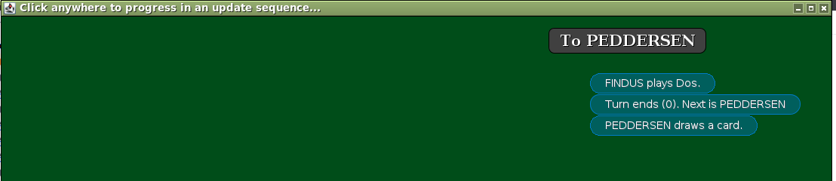
But (2)…
Some visual tests require Peddersen to do stuff
  We cannot test ‘attackCard()’s visual behavior unless Peddersen has some minions on the field, right?
Easy (?)
  Just call endTurn()… Ups?!?
    How do get rid of that state of the UI???
Game is not responsible for controlling a
‘switch player’ state.
Thus this is a pure UI state. And must be treated as such…

Slide 40
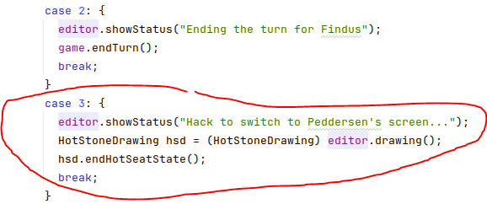
But (2) …
Our TriggerUpdateTool must therefore handle this…
The trick is:
  Force the UI state change directly from our scaffolding code…

Slide 41
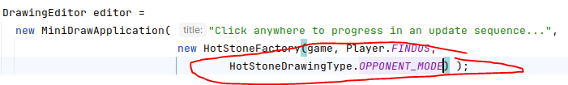
But (2) Alternative…
An alternative route is to use HotStoneDrawing in its ‘opponent mode’
  Which is designed for remote play
    The UI is always tied to one specific player
      Here it is Findus.
  Now a ‘case n:’ state can:
    endTurn(); (do some Peddersen mutator calls); endTurn();
    Remember – you must end in a state where Findus is in turn!

Slide 42
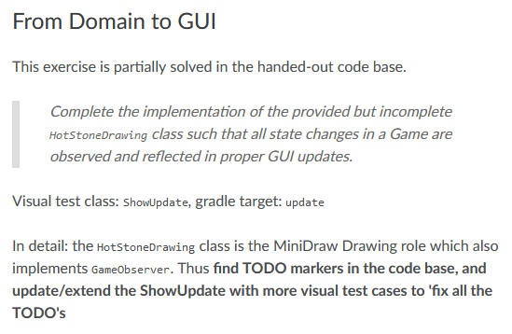
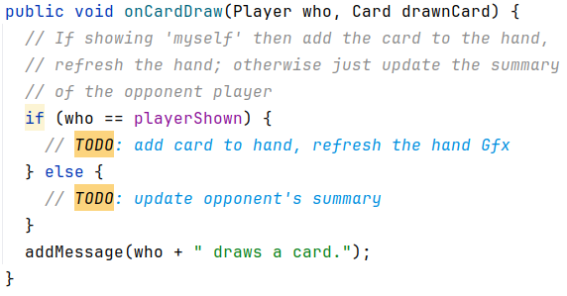
Mandatory: Domain to GUI
The first MiniDraw related exercise on Iteration 8
Look for TODO comments in the code.

Slide 43
GUI to Domain

Slide 44
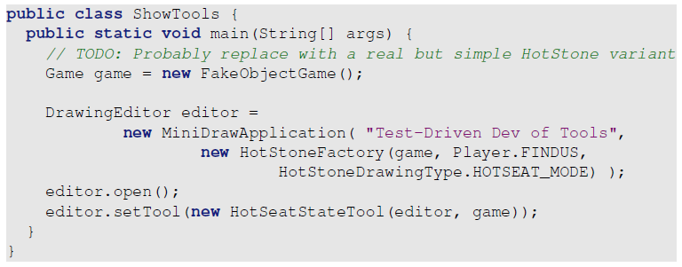
GUI to Domain
ShowTools is a visual test program
Process
  Pick a ‘user action’ = tool to implement
  Develop Xtool (+ extend HotSeatStateTool) for that until OK
  Loop until all four user actions are done…

Slide 45
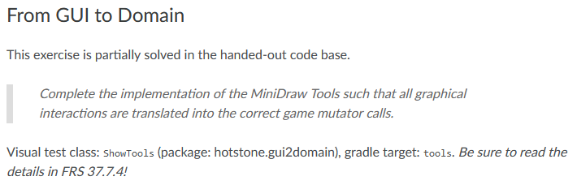
Mandatory: GUI to Domain
That is
Again, use a real game implementation rather than my FakeObject game
  Exercise: Why do the provided code use a FakeObject Game?
Notes:
Because I will not give you my AlphaStone code, right ☺

Slide 46
System Testing
Play the Game.
Finally!

Slide 47
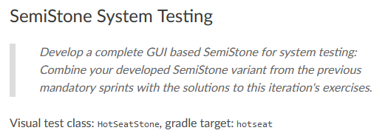
System Testing
And – Ta daa!
Play any of the variants…

Slide 48
Two SubSystems
=
Two set of Terms/Objects

Slide 49

Domain and GUI Terms
Domain / Game speaks in terms of Card, Hero, Player
  To represent the roles of a card, a hero, …
GUI / MiniDraw speaks in terms of CardFigure, HeroFigure, …
  To represent the roles of a card, a hero
We need to translate between one and the other when the two subsystems interact…

Slide 50


Coupling Domain and Gfx
The Observer onX() calls “speaks in domain terms”
But these have to be translated into MiniDraw Gfx equivalents: A card is drawn as a CardFigure…
  Solution: Drawing keeps a mapping between the two

Slide 51
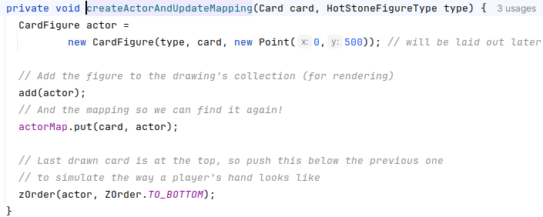
Coupling Domain and Gfx
In
A simple does the trick

Slide 52
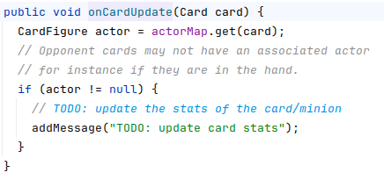
Coupling Domain and Gfx
Which allows us to handle onCardUpdate(), simply by looking up that card

Slide 53

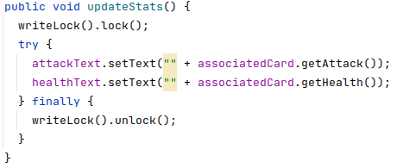
And The Other Way
We need the link the other way as well
  The Figure needs access to its associated Card/minion

Slide 54

Liability of a Mapping
The big downside of a mapping !
  Your code has to ensure they do not get out of sync!
    Looking up a Figure which is not there ☹
Solution is
  Uncle Bob: One Level Of Abstraction
    Never manipulate map directly, use private methods
  And lots of testing!

Slide 55
Module View
Organization of interfaces/classes

Slide 56
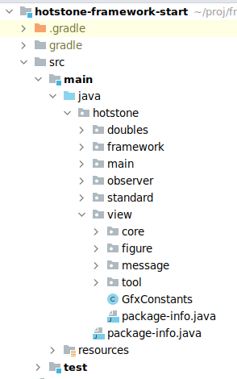
The Provided Code…
Provided Zip adds a lot of new code to your HotStone
  Merge carefully, temporary stubs for StandardGame, may overwrite all your work!
  Do it on a branch!!! Make a backup
New UI specific packages

Slide 57
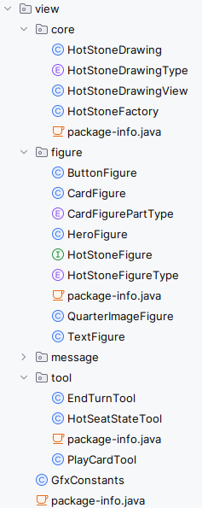
Package Contents
Core
  MiniDraw ‘Drawing’ and ‘View’ roles
    Partially implemented for you
Figure
  MiniDraw ‘Figure’s
Message
  Aux roles
Tool
  MiniDraw ‘Tool’ roles
    Partially provided for you
GfxConstants All layout stored there

Slide 58
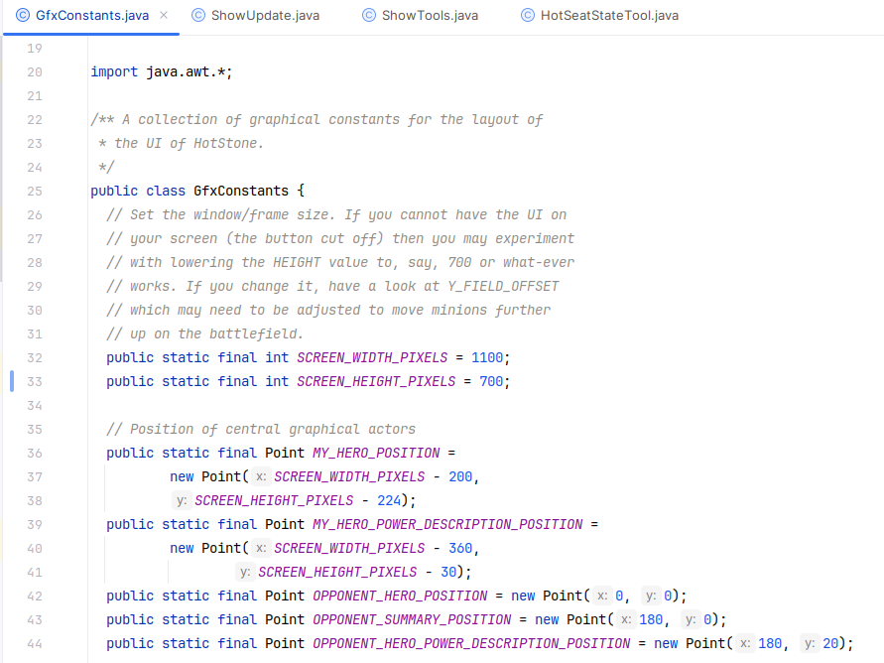
GfxConstants
Controlling (most) graphical layouts
  The Peter Bøgh projectors are 1600x900 pixels so I have to adjust the
    SCREEN_HEIGHT_PIXEL
Play around to find the
most pleasing size on
your machine…
(No viewpoint in MiniDraw,
sorry…)

Slide 59
Happy Coding…

